Slide 1
ESP CORE ACCOUNTING MODEL

Slide 2

ENTERPRISE SERVICING PLATFORM (ESP)
OVERVIEW:
This project covers creation of a model catalog to provide consolidated view of models within the Bank, with an API for searching and querying, as well as the creation of source agnostic model.
State Street’s Enterprise Servicing Platform [ESP] provides a fully customizable and scalable end to end Enterprise Data Management platform. Powered by State Street’s superior accounting and performance capabilities and fully integrated with State Streets award-winning information delivery capabilities, ESP provides an end-to-end solution.
ESP allows for easy integration with batch, real time, and one-time data sources from client or 3rd party data providers. Its robust self-service capabilities allow for rapid platform extensibility without incurring typical technology development. It has the ability to store and aggregate information “As at” and “As of ” from multiple sources. ESP has integrated control hub to improve timeliness and accuracy of data.

Slide 3
ENTERPRISE SERVICING PLATFORM (ESP)
The Problem
The Solution
Legacy Warehouse limitations deny our clients the ability to view, aggregate, and dynamically interact with data at an enterprise level
State Street has implemented a cutting-edge, Real-Time, Cloud-Infrastructure based warehouse, with Self-Service capability
Data Challenges
Increasing regulatory requirements, high pace of change, need for transparency and the ability to quickly access data
Disparate data sources feeding a complex array of systems/platforms make it difficult for customers to distill data into the enterprise views they need of their businesses.
Batch File uploads, data not available real-time
Operational Errors, Client Report Data Inconsistency
Comingled data in single schema with limited accountability
Lacking Business Analysis Capability / Onerous Development
Static data model, change is costly
Limited trending, hard to troubleshoot data issues
Custom programing required to load and normalize data, build extracts or create reports
High Infrastructure Cost and long lead time to procure hardware
Expensive hardware, license, and maintenance requirements
Fixed storage capacity, long lead times to expand
On-site Hardware requirements
End-to-End Data Management
Enterprise view of data from disparate sources
Data Transformation/Calculation – Progressive data model
Data Ownership and Accountability
Complete Audit trail – AsOf and AsAt Capability
Data Lineage Tracking
Multiple, open and secure data access methods
Real time data integration
Time to Market
User Empowerment - Self-Service
Adapt to change - completely configurable data model
Leading Technology and Design
Meta-Model Driven (Business View separate from Physical)
On-Demand provisioning, Elastic Capacity)
Resilient and Controlled
Integrated control to improve timeliness and quality
Comprehensive monitoring and support dashboards
Integrated Change management
State Street’s Enterprise Servicing Platform enables World-Class Information Delivery, supporting the data requirements across the spectrum of Investment Management business processes.

Slide 4
Transform Data into Actionable Information
End-to-End Enterprise Data Management
Meta-Rules Self-Service Interface
Acquisition
Transformation
Consumption
DATA
Customizable
INFORMATION
Dynamic
Extensible
Governance
Security
Administration

Slide 5
Transform Data into Actionable Information
End-to-End Enterprise Data Management
Meta-Rules Self-Service Interface
Acquisition
Transformation
Consumption
Data Access
/ Ingestion
Data Loading
Data Categorization / Maintenance
Data Modeling
Data Mart Creation
Data Enrichment & Augmentation
Data Analytics
Data Query
Data Extraction
Data Delivery
DATA
INFORMATION
Data Mart Storage
Governance
Security
Administration
Notes:
5

Slide 6

Single, Dynamic, Customizable, Scalable Platform to meet extensive reporting and data needs
End-to-End Data Management
Supports data from provisioning through consumption
Real time data delivery to improve decision-making and business transparency
Data retained historically both by as of and as at
Data stored by Source, Category and Time
Self Service Configuration (Not Traditional IT Involvement)
Completely configurable progressive data model
Data structures configured through self-service tool
Robust self-service data mart configuration tool
Full data lineage tracking
Fully Meta-Data Driven
Separates the data model from the physical design
Enables new tables and columns to be created in a self service mode
Dynamically creates services to access data
Private Cloud Enabled Technology
On-Demand provisioning, Elastic Capacity
Virtualization, Pay per Use
Enhanced Information Delivery Strategy
Data proxies (JDBC, .net, ODBC) to allow customers access to their data securely and with high scale
ESP SQL Drivers can be used with any 3rd party BI tool
Integrated with State Street reporting tools
Self Service
Tool
Customized Reporting
Private Cloud Technology
Enterprise Data Solution
Enhanced Information Delivery
Meta-Data Driven
End-to-End
Data Management
Notes:
State Street’s Enterprise Servicing Platform [ESP] provides a complete data warehousing solution to State Street clients. It gives asset managers and asset owners a dynamic, customizable, and scalable self-service platform for all their data needs. Integrated with State Street’s IBOR, ABOR and performance capabilities and fully integrated with State Streets award-winning information delivery capabilities, ESP provides an end-to-end solution.
ESP allows for easy integration with batch, real time, and one-time data sources from client or 3rd party data providers. Its robust self-service capabilities allow for rapid platform extensibility without incurring typical technology development. It has the ability to store and aggregate information “As at” and “As of” from multiple sources and dynamically-created hierarchies. ESP provides clients with one data platform that is dynamic enough to meet customization requirements yet complete enough to meet end to end front, middle, and back office data and information delivery needs of sophisticated asset managers and asset owners.

Slide 7

Data Management and Information Delivery Tool Set
Configure
Enterprise Servicing Platform
Aggregate
Real Time Data Flow
Client & 3rd Party Data
Reference
Market
ABOR
IBOR
Regulatory
Category X
PnA
Risk
Source & Manage Data
Data Categories & Data Marts
Real Time
Client & 3rd Party Data
Powerful and Flexible Control Definition
Enterprise Control Framework
Management and Workflow Dashboard
Custodians
Security Codes
Classifications
Asset Types
Portfolios
IMs
Benchmarks
Custom Reference Checks
Tolerance & Comparison Checks
Data Integrity & Availability Checks
Report design tool for customised report outputs
Work flow and packaging for value-add and end client reporting
Data feeds in your specified file format
Direct access to our data warehouse
Information
Delivery
MyStateStreet.com Model
(Interactive Views/Report Center/Dashboards/Workflow)
Full Integration Model
Open Access to Data
Information Consumers
Client Platforms
CONFIDENTIAL

Slide 8
Data Management and Information Delivery Tool Set
Configure
Enterprise Servicing Platform
Aggregate
Real Time Data Flow
Cleint & 3rd Party Data
Reference
Market
ABOR
IBOR
Regulatory
Category X
PnA
Risk
Source & Manage Data
Data Categories & Data Marts
Real Time
VFMC & 3rd Party Data
Powerful and Flexible Control Definition
Enterprise Control Framework
Management and Workflow Dashboard
Investment Ops
Security Codes
Classifications
Asset Types
Portfolios
IMs
Benchmarks
Custom Reference Checks
Tolerance & Comparison Checks
Data Integrity & Availability Checks
Report design tool for customised report outputs
Work flow and packaging for end client reporting
Raw data feeds to your requirements
Direct access to our data warehouse
Information
Delivery
MyStateStreet.com Model
(Interactive Views/Report Center/Dashboards/Workflow)
Full Integration Model
Open Access to Data
Information Consumers
Client Platforms
Notes:
Build out client and third party data to suit VFMC’s needs
Emphasis ability to integrate with Simcorp (format, timing, data etc)
General aesthetics
Talking Points
Data Marts
All Client information delivery and access needs through Data Marts
Web based Self-Service User Interface
Meta Model rules based Data Mart definition/creation
Meta Model rules based Data Mart refresh
Event, Time based or On Demand
Processing Order dependencies
Refresh Synchronization for Data Marts with common refresh rules
Self Service Data Mart creation
Data Mart definition/creation by Data Analysts (Client or State Street)
Post processing within the Mart using Plug-able Java Module (second pass reallocation processing, complex calculation logic, etc.)
Data Marts based on Core or Custom Hierarchies and Classification Schemes
Rule based Data Mart History (As Of and As At)
Robust Mart management capabilities to encourage Mart sharing and reuse and to avoid the creation of overlapping or redundant Mart definition
Powerful search capability using mart definition metadata (e.g. search by category, refresh even, aggregation hierarchy
Information Delivery
Web based Self-Service User Interface – MySS.com
Formatted Reporting – Report Center
Parameterized Standard Reports (Pre-defined layout)
User Designed Reports (User defined layouts)
Report Scheduling, Packaging and Delivery
End Client Reporting (Report Packaging and Operational Workflow)
Interactive Data Analysis – MySS Interactive Views, Interactive Spreadsheets, Dashboards
Programmatic Access – SQL (Web Services)
Notifications – MySS Alert Center, MQ Outbound
Data Feeds/Extracts (Standard feed per Data Mart, User defined)
Data Consumption using ESP Drivers (directly from Client Environment)
ESP Drivers can be used with any third party tool supporting JDBC, ODBC or ADO.net drivers
Commercially available reporting tools
MS-Excel, MS-Access etc.
Programmatic Access (Client Applications)

Slide 9



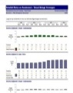
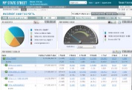
[Sample Application of Tool Set to solve problems]
SSC
ABOR
SSC
IBOR
External Manager CSV Files
Indices
(ASX. MSCI World, S&P 500, FSTE)
Futures Composition
SWAP Contracts
Source
Data
Look Through Data Management (ESP)
SSIA - Analytics
Performance
External Data
Data Customization
Consolidation
Enrichment
Security Master Extension
Portfolio Position Data
Attribution
REPORTS
RESEARCH
Look
Through
Security Decomposition
Look through Data alignment
Internal Data
PDF
Fund to Fund Ratios
Market Data Enrichment
Compliance
TXT
XLS
DASHBOARDSM
FILES/DATA FEED
Enterprise Control Framework
Data Interrogation
Data Integrity & Availability
Reference Data Validation
Tolerance & Comparison Checks
Data Reconciliation
Information
Delivery
Target System A
Target System B
MyStateStreet.com

Slide 10
Data Acquisition
Data Access
/ Ingestion
Internal or third party data providers
One time, real-time and batch sources
Structured and semi-structured (XML; JSON, email, EDI) data types
Emerging unstructured capability (integration with Cloudera)
Data Loading
Self-service and Java plug-in pre-processing capabilities
Transform data prior to/post-load; accommodates new data sources
Define categories/inbound data feed mapping w/out IT
Rules-based orchestration to manage order/timing of data feeds
Supports SFTP, MQ, and Web services; mapped to physical DBs
Meta-Rules Self-Service Interface
Data Categorization / Maintenance
Bring data into ESP in a controlled/auditable way
Tag and store data in dynamically created hierarchies
Owner, Source, Category & Time (As At; As Of; Sysdate)
Establish critical framework for data sharing and security
Enable full data lineage tracking back to source data
Notes:
10

Slide 11
Data Transformation
Data Modeling
Meta-model driven solution
Separates data model from physical system
Separates business rules from application code
Users create complex Meta-models w/out IT
Data Mart Creation
Meta-model is key enabler for data mart creation
Create ready-to-use data marts based on defined business rules
Data marts reflect specific user/group needs
Can customize further by registering new files into the system
Data Mart Storage
Meta-Rules Self-Service Interface
Data Enrichment & Augmentation
Leverages progression database architecture
Merges, integrates, calculates and aggregates data
Auto refreshes Data Categories as new data arrives
Automatically creates new data and new data marts
Data Analytics
Leverages a parallel execution grid framework
Processes data mart workloads in parallel
Continuously updates/refreshes data marts on near-real time basis
Enables sub-second response times on large, complex data sets
Notes:
11

Slide 12
Data Consumption
Data Query
Leverages data cloud services
Unique data proxy technology converts SQL to Web services
ODBC, JDBC or .NET; encodes SQL commands into XML data
Use web packets to create new data marts
Data Extraction
Also leverages data cloud services
Makes it easy to extract data from ready-to-use data marts
Manual or system generated requests
SQL, SQL Web services, MQ, standard file transfer (SFTP; NDM)
Meta-Rules Self-Service Interface
Data Delivery
Architected with very light reporting layer
Allow users to prepare data once and publish to many environments
Secure and reliable connections to BI tools; remote systems
Can export data in multiple formats (Excel; .pdf and csv)
Notes:
12

Slide 13
Data Governance
Workflow / Data Accuracy
(ECF/OCF)
Data Lineage Tracking
Change Management
Data Discovery & Reuse
ECF/OCF Frameworks:
Integrated control hub ensuring quality and consistency of data
Defines content, quality, schedule and retention data policies
Controls Ops Life-Cycle through predictive deliverables tracking
Data Tracking:
Full data lineage tracking from data intake to distribution
Multiple levels of temporal storage (As At; As Of)
Integrated Change Management:
Meta-Model Change Management Framework
Ability to import changes in to production environment
Data Discovery/Reuse:
Entitled users can easily search catalog of data
Search by data [element, Owner, Source, Category, data mart/feed]
Enables data mart sharing and reuse; avoids mart redundancy
Integrated Control and Governance
Notes:
13

Slide 14
ESP Semantic (Meta-data) Layer
Data Elements
Data Dictionary
Attribute definition
Used to define Categories and Marts
Enforce consistency
Data Categories
Logical categorization of Data Elements
Store inbound data by Category, Source and Time
Mapped to physical database tables
Data Feed Mapping
Feed / Message mapping to Categories
Data acquisition method definition
Validation rules
Orchestration rules
Data Marts
Information delivery through Marts
Data Category join rules
Source hierarchies (pecking order)
Aggregation hierarchies and classifications
Calculated data elements
Orchestration rules
Mapped to physical database tables

Slide 15
Sample Data Mart Structures
Transactions
Portfolio Ref
Transaction ID
Portfolio Code
Asset ID
Security Name
Trade Date
Settlement Date
Share / Par
Market Value
Price
Commissions
Broker Code
Portfolio code
Portfolio name
Region
Positions
Portfolio Code
Asset ID
Share / Par
Local Market Value
Base Market Value
Price
Base Cost
Categories
Broker Ref
Security Ref
Broker Code
Broker Name
Broker location
Asset ID
Security Name
Asset class
Sector
Industry
Transactions Data Mart
Positions Data Mart
Transaction ID
Portfolio Code
Portfolio name
Asset ID
Security Name
Trade Date
Settlement Date
Share / Par
Market Value
Price
Commission
Broker Code
Broker Name
Portfolio Code
Portfolio name
Asset ID
Security Name
Asset class
Sector
Industry
Share / Par
Local Market Value
Base Market Value
Price
Base Cost
Data Marts

Slide 16
Tool Set Differentiators and Client Benefits
Client Challenges | Solution/Differentiator | Client Benefit
Enterprise Data Management and Control | All data can be managed and controlled to ensure business critical data is checked for completeness, accuracy, and timeliness. | Clients have a contact point for the DATA itself. Data management and information delivery is an end to end business service.
Data Strategy and Scope | Meta data driven allowing for separation of the physical and logical data models, enabling robust self-service data warehousing capabilities. Any internal or external data source can be integrated with the platform. | Removes the need for DBAs to make changes to the data model, thereby reducing handoffs and decreasing implementation time and cost. Allows resources to manage customized data models, improving efficiency and quality.
Data Delivery and Timeliness | ESP has full data lineage tracking from source to usage based on the same meta data that defines the model. Fully customizable information delivery. | Allows for robust data governance expanding usability of data. Clients can decide format and method for data delivery and access on-line.
Data Delivery, Scalability and Security | ESP has a set of data proxies(ODBC, JDBC, ADO.net) to allow customers to connect standard BI tools to their data securely with high scale (enabled through the secure web service cloud on which ESP is built). | Flexible data extraction allows for flexibility and seamless integration with downstream systems. Reduces overhead costs for hardware and related support, leverages State Street’s robust security framework.
Data Quality and Timeliness | ESP auto-refreshes data marts on a near real-time basis (triggered by new data coming into the inbound hub) | Provides the capability to store and report business critical data on a near real-time basis. Allows for support of time sensitive front office data and other related functions.

Slide 17
ESP Architecture Overview
DATA PROVIDERS
External Providers
Internal Systems
Source
Source
Source
Source
Source
Source
Source
Source
Source
PLATFORM
Data Hub
Inbound
MQ
SFTP, NDM, etc.
Data Replication
Services
Feed Repository
Internal/External
Internal/External
Internal/External
Data Categories
Engine
Data
Data
Data
Data
Data
Triggers
Scheduler
Meta Rules/Model
Source/Category/Time
Mart Generator / Refresher
Data Marts
Transient/Persistent
Intermediate/Consumption
Data
Data
Data
Data
Data
Data
Data
Data
Data
Data
Data
DATA SERVICES LAYER
Data Hub Outbound
SFTP, NDM, etc
MQ
Web Services
Drivers
JDBC
ODBC
ADO.NET
INFORMATION DELIVERY
Report/BI Tools
Meta Rules Self-Service Interface
Remote Systems
SQL Tools
Technology Key
Note: The arrows in the picture show the flow of data. The majority of the connections have bi-directional communication however for clarity sake only the primary flow of core data is depicted.
Many/ General
Oracle/Exadata
Flex
MQ
C++
Java
Agent
Notes:
17

Slide 18
Enterprise Data Control Framework
Solving a Growing Market Challenge with the State Street’s Enterprise Control Framework.
Client Problem
Our Approach
Disparate data sources feeding a complex array of systems, platforms, and bespoke solutions make it difficult for customers to distill data into the enterprise views they need of their businesses.
Firms are struggling with new global regulatory requirements, increasing complexity, high pace of change, need for transparency, and the ability to quickly access data required to drive sound investment and risk decisions.
Investment Managers need next-generation data warehousing and analytics in a unified system that is flexible, scalable, and intelligent enough to service all of their business functions.
State Street has developed and deployed a powerful data management ecosystem enabling strategic data management and governance.
Our Enterprise Servicing Platform (ESP) transforms, rationalizes and aggregates data in real-time. Features include: Full Self Service Data Management Capabilities, Robust Extensibility and Transparency, Real-Time and Event Driven Processing, High Resiliency and Security.
A comprehensive Enterprise IBOR serves as a primary data source for ESP
Value added services such as Performance Measurement, Analytics, Risk and Reporting are enabled with improved data quality and timeliness.
Effective Data Management
Chaos
Managed Through a Strong Data Governance Program
Control
Events, Structured & Unstructured Data From Multiple Sources
Validate and Control Data Timeliness and Accuracy
Continuously Analyze, Adjust, Trend, Improve, Aggregate, and Refresh
Cloud enabled, self service access to quality and timely data
Translate, Transform, and Enrich
Enterprise Control Framework
The Enterprise Control Framework is an industry leading Data Control Hub that leverages the power and flexibility of ESP.
Enables preventative and detective data controls with predictive notification to improve information delivery, accuracy, and timeliness.
Framework leverages automated services to analyze and hold data, from any source, accountable to deliverables or to another service dependency.
Dynamic and intelligent engines and algorithms are used to predict data relationships, service requirements, and dependencies.
Flexibility to cover any deliverable, including: real time data delivery, ad-hoc data access, and scheduled data delivery to front office or end clients.
Extensive self service query capabilities with rules engines, data lineage, and analysis tools; enabling business users to quickly react to increasing data complexity and pace of data change.
Notes:
Potentially a stand alone slide paired with a demo

Slide 19
The solutions to your data management challenges
Source Data
Data Challenges
Batch File uploads, data not available real-time
Comingled data in single schema with limited accountability
Lacking Business Analysis Capability / Onerous Development
Static data model, change is costly
High Infrastructure Costs
Expensive hardware, license, and maintenance requirements
Fixed storage capacity, long lead times to expand
End-to-End Data Management
Real time data delivery to improve decision-making and business transparency
Scalable and Flexible
On-Demand provisioning, Elastic Capacity (SaaS Platform)
Powerful Technology and Dynamic Toolset
Continuous data refresh from streaming sources
Manage Data
Data Challenges
Disparate data sources feeding a complex array of systems/platforms make it difficult for customers to distill data into the enterprise views they need of their businesses.
Operational Errors, Client Report Data Inconsistency
Lacking Business Analysis Capability / Onerous Development
Limited trending, hard to troubleshoot data issues
End-to-End Data Management
Enterprise view of data from disparate internal and external sources
Scalable and Flexible
Completely configurable data model, end to end Self-Service
Resilient and Controlled
Eliminates data inconsistency issues created by multiple copies or multiple sources for the same data
Deliver Information
Data Challenges
Increasing regulatory requirements, high pace of change, need for transparency and the ability to quickly access data
Lacking Business Analysis Capability / Onerous Development
Custom programing required to load and normalize data, build extracts or create reports
High Infrastructure Costs
On-site Hardware requirements
Powerful Technology and Dynamic Toolset
Business Intelligence / Analysis, Full data lineage
Multiple, secure data access methods
Resilient and Controlled
Pro-Active, comprehensive monitoring and support
Integrated control to improve timeliness and quality
Notes:
Build out client and third party data
Emphasis ability to integrate with client’s existing systems (format, timing, data etc)
General aesthetics
Talking Points
Data Marts
All Client information delivery and access needs through Data Marts
Web based Self-Service User Interface
Meta Model rules based Data Mart definition/creation
Meta Model rules based Data Mart refresh
Event, Time based or On Demand
Processing Order dependencies
Refresh Synchronization for Data Marts with common refresh rules
Self Service Data Mart creation
Data Mart definition/creation by Data Analysts (Client or State Street)
Post processing within the Mart using Plug-able Java Module (second pass reallocation processing, complex calculation logic, etc.)
Data Marts based on Core or Custom Hierarchies and Classification Schemes
Rule based Data Mart History (As Of and As At)
Robust Mart management capabilities to encourage Mart sharing and reuse and to avoid the creation of overlapping or redundant Mart definition
Powerful search capability using mart definition metadata (e.g. search by category, refresh even, aggregation hierarchy
Information Delivery
Web based Self-Service User Interface – MySS.com
Formatted Reporting – Report Center
Parameterized Standard Reports (Pre-defined layout)
User Designed Reports (User defined layouts)
Report Scheduling, Packaging and Delivery
End Client Reporting (Report Packaging and Operational Workflow)
Interactive Data Analysis – MySS Interactive Views, Interactive Spreadsheets, Dashboards
Programmatic Access – SQL (Web Services)
Notifications – MySS Alert Center, MQ Outbound
Data Feeds/Extracts (Standard feed per Data Mart, User defined)
Data Consumption using ESP Drivers (directly from Client Environment)
ESP Drivers can be used with any third party tool supporting JDBC, ODBC or ADO.net drivers
Commercially available reporting tools
MS-Excel, MS-Access etc.
Programmatic Access (Client Applications)

Slide 20
ENTERPRISE SERVICING PLATFORM (ESP)
World-Class Information Delivery
Leading Technology and Design
Data Consumption and Normalization
Data Control and Monitoring
Data Management
Cloud Virtual Infrastructure
Faster provisioning
Capacity on demand scale
Reduced operational complexity
Decreased network consumption
Information Access for SaaS Data Warehouse
Portal
SQL Web Proxies (ODBC, JDBC, .net)
Business Intelligence tools
Real-time Data
Continuous refresh from streaming sources
Highly optimized
Ensures data access consistency
Meta-Model Driven
Separation from physical design
Enables new tables to be created self-service
Separating business rules from application code
Technology agnostic
Multiple tenant
Secure, segregated storage
Consistent platform across customers
Supports Diverse Sources
Store data from any source, category
Client, Market, Reference, Counterparty, Custodian
Create Data Marts from Data sources
Translate, Transform, Enrich
Data Feed Mapping
Data loader for inbound data
Data acquisition method definition
Feed / Message mapping to Categories
Mapped to physical databases
Defined validation rules
Data Categories
Logical categorization of Data Elements
Enforce consistency
Data Marts
Data category join rules
Source hierarchy
Aggregation and Classification
Calculated Data Elements
Orchestration rules
Self-Service
Data Definition, Data Loading, Mart Definition
Data Analysis
Data Lineage tracking
Enables Business Intelligence Tools
Accessible via Reporting Tools
Supports export to Excel, etc.
Continuous Monitoring
Real-time data refresh ensures data access consistency
Streaming data sources continuous update identification
Security
Multiple, secure access methods
Insert only (AS AT time series preserved)
Self-Service
Flexible reporting and control capabilities
Integrated Control
Supports the creation of custom business validation checks and controls
Ensures data availability, completeness, timeliness, and accuracy
Automation of data validation and relational integrity checks
Enables preventative and detective data controls with predictive notification
Data Ownership
All data has clear ownership with defined quality levels
Time Dimension
Multiple levels of temporal storage controls adjustments in arrears
Extensible
New data categories, sources, and data points are easily added
Discovery and reuse
Catalog of available, ready-to-use data marts are created from categories
Merge, compute, aggregate
Ready-to-use data marts are created from categories
Data Lineage tracking
Clear audit trail for the origin of all data and the refresh of data
Security
Granular control of function and data entitlements
Resiliency
Data is always available
Event Driven
Support for continuous receipt, classification, processing of data
Consistency
Data inconsistency at the enterprise level is avoided through sound governance
Data Governance

Slide 21
Information Delivery - multiple, secure data access methods
ESP has a set of data proxies(ODBC, JDBC, .net) to allow customers to access their data securely with high scale (enabled through the secure web service cloud on which ESP is built)
Data can be accessed using standard BI tools, MS-Excel/Access or programmatically
Custom Outbound Data Extracts
Configured to requirements
Integration with State Street’s Information Delivery Platform (my.statestreet.com)
Reporting (Report Center)
Interactive Report Designer (IRD)
Time and Event based Scheduling
End Client Reporting (Report Packaging and Operational Workflow)
Multiple Delivery Channels
Interactive Data Analysis
Interactive Views
Interactive Spreadsheets
Dashboards
Events and Notifications

Slide 22
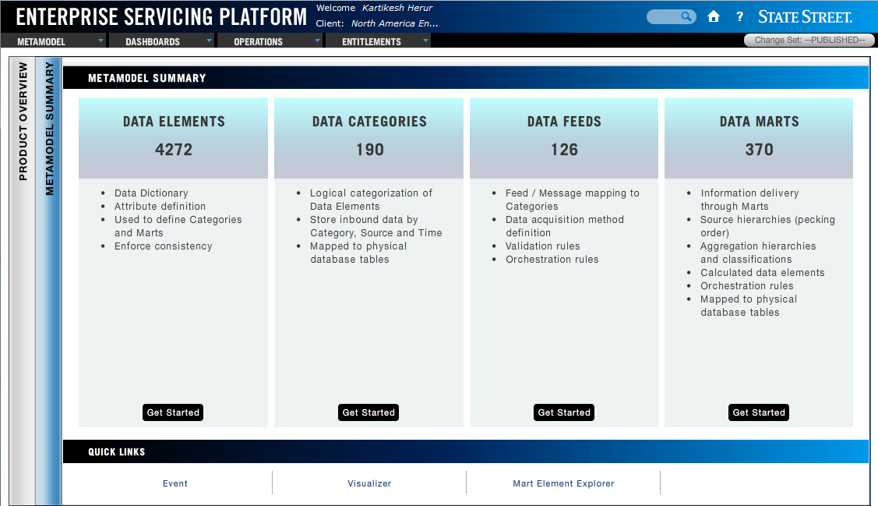
ESP Overview: Platform Building Blocks
Data Elements:
Data Dictionary
Used to define Categories and Marts
Attribute definition
Enforce consistency
Data Categories:
Logical categorization of Data Elements
Store inbound data by Category, Source and Time
Mapped to physical database tables
Inbound Data Feeds:
Feed / Message mapping to Categories
Data acquisition method definition
Validation rules
Orchestration rules
Data Marts:
Information delivery through Marts
Data Category join rules
Source hierarchies (pecking order)
Aggregation hierarchies and classifications
Calculated data elements
Orchestration rules
Mapped to physical database tables
There are four main building blocks in ESP, each of which represents a different level where data can be transformed, aggregated and enriched to create a consumable, holistic view
Notes:
KARTIK & ADAM

Slide 23
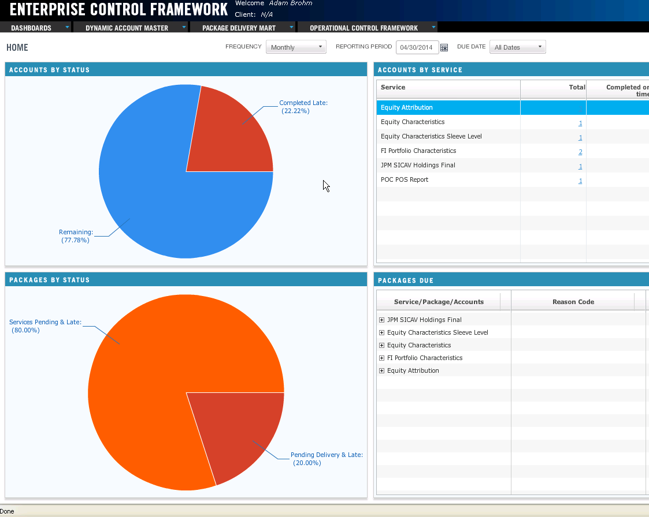
Management and Workflow Dashboard
Management View: The Enterprise Control Framework Dashboard can be configured to provide a comprehensive graphical view of Account, Report, Package, Feed, or Deliverable Status.
Detail Navigation: The ECF Dashboard allows users to ‘drill down’ into specific chart elements (i.e. pie wedges) or supporting numerical details to obtain more information about the specific components (i.e. accounts, packages, etc.) included in a particular grouping.
Functional Role-Based Views: The ECF Dashboard can be configured to display different charts, data elements, views based on User ID, this enables tailored views (such as: Client Reporting, Performance, Reconciliation, or Data Control views emphasizing the information most importation to each group.
Workflow : The ECF Dashboard is designed to support Workflow Management and pro-active tracking of deliverable status, Service Level Agreement, Hard Dates, Soft Dates, and reasons codes.
ECF’s configurable Dashboard provides role-based, summary views for operations and management. These summary views can be visually explored, allowing users to ‘drill down’ into the schema and expose the specific elements (accounts, packages, reports, etc.) which make up a particular graph component or metric. This enables different groups (Client Reporting, Performance, Client Management) to quickly understand status, focus attention, and drive workflow to support their critical success factors.

Slide 24
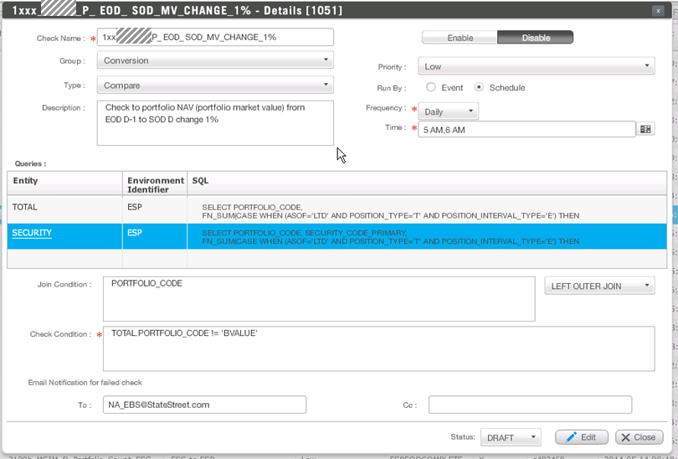
Powerful and Flexible Control Definition
Business Configuration: OCF is a self-service tool, designed with the flexibility to allow select Business Users to create new data controls, without requirement for additional IT development.
Scheduled or Ad Hoc: Checks can be configured to run on specific Business Days or Calendar Days and at a specific time or times throughout the day or be event driven.
Source Agnostic: Checks can be defined to select / combine / evaluate data from a broad range of internal or external sources.
Custom Logic : Using Structured Query Language Business Controls can be tailored to client specific tolerances, asset types, transactions, and exceptions.
The Operational Control Framework (OCF) enables State Street to easily configure powerful business-oriented data controls, which can interrogate and combine data from various source systems with flexible or event driven scheduling. This enables State Street to quickly implement checks which adapt to our client’s specific requirements, evolving priorities, and a dynamic business and regulatory environment.

